Slide 1
Windows Azure Virtual Machines
Microsoft Research
Windows Azure for Research Training

Slide 2
Virtual Machines
Learning objectives – what you will learn:
Wide variety of pre-configured virtual machines available from the gallery
How to make your own virtual machine from an existing installation
An example using Windows and Visual Studio
An example using Linux and IPython notebook

Slide 3
Agenda
IaaS recap (Infrastructure as a Service)
Provisioning VMs in the cloud
Windows and Linux VMs
VM gallery
VM sizes and reliability
VM disks and images
Demos
Notes:
Slide Objectives:
Introduce the topics that will be covered in this session
VALUE PROP
Speaking Points:
Notes:

Slide 4





A Continuous Offering From Private to Public Cloud
Physical
Virtual
IaaS
PaaS
SaaS
Notes:
Slide Objective:
Microsoft provides a continuous solution from private cloud to the public cloud. No matter where you are on your technology roadmap we have a solution to fit your needs.
We are a trusted advisor and platform in the traditional enterprise and ISV space and with the new IaaS offering we are making it easier to bring this same level of trust and ease of use to the public cloud.

Slide 5


Cloud-First Provisioning of VMs
Getting Started
Select Image and VM Size
New Disk Persisted in Storage
Windows Server
Management Portal
Boot VM from New Disk
Linux
>_
Extra Small
Small
Medium
Large
X-Large
Scripting
(Windows, Linux and Mac)
Cloud
REST API
Notes:
Slide Objective:
Explain workflow for provisioning VMs in the cloud
Notes:
Cloud First Provisioning means exactly what is says. Building a VM in the cloud first.
You have three methods of starting this process: Build a VM from the portal, from the command line OR programmatically calling the REST API.
Once your choice of provisioning is made you will need to select the image and instance size to start from.
The newly created disk will be stored in blob storage and your machine will boot.

Slide 6
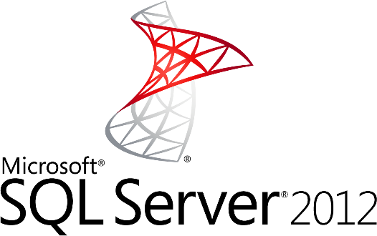
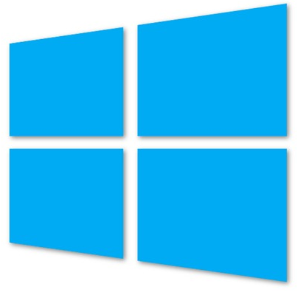

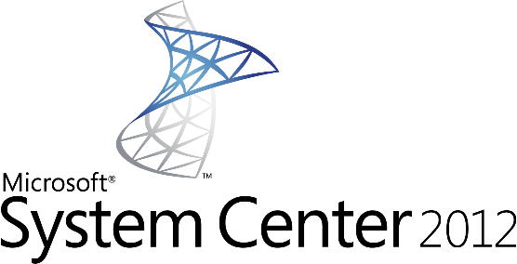
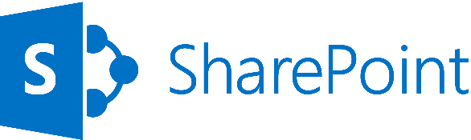
Supported Windows Server Applications
SQL Server 2008
SQL Server 2008 R2
SQL Server 2012
Windows Server 2008 R2
Windows Server 2012
SharePoint 2010 & 2013
BizTalk 2010 & 2013
System Center 2012
http://support.microsoft.com/kb/2721672
Notes:
Windows Server Windows Server 2008 R2 and later versions are supported for the following roles:
Active Directory Domain Services
Active Directory Federation Services
Active Directory Lightweight Directory Services
Application Server
DNS Server
Fax Server
Network Policy and Access Services
Print and Document Services
Web Server (IIS)
Windows Deployment Services
Windows Server Update Services
File Services

Slide 7





Linux on Windows Azure
We will support
SUSE SLES 11 sp2
Open SUSE 12.1
CentOS 6.2 by OpenLogic*
Ubuntu 12.04
Specific versions are endorsed
Integration Components
Testing and validation by partners
Bring other variants at your own risk**
*Image provided by OpenLogic based on CentOS 6.2
**Integration Work will be needed
Notes:
Slide Objectives:
Provide an understanding of which Distributions of Linux are offered in the Windows Azure Image Gallery.
Speaking Points:
1) Only Certain distributions of Linux are officially supported: SUSE Enterprise 11 SP2, OpenSUSE 12.1, CentOS 6.2, Ubuntu 12.04
2) Virtual Machine Images of these Distributions are provided by Partners who are experts in each distribution
3) Other Distributions of Linux can be installed as “Bring-Your-Own-Linux” however, some integration work will be needed.
Notes:
Linux Virtual Machines Product Page: http://www.windowsazure.com/en-us/manage/linux

Slide 8

Gallery Images Available
Microsoft
Windows Server 2008 R2
SQL Server Eval 2012
Windows Server 2012
Biztalk Server 2013 Beta
Open Source
OpenSUSE 12.2
CentOS 6.3
Ubuntu 12.04/12.10
SUSE Linux Enterprise Server 11 SP2

Slide 9
Virtual Machine Sizes
VM Size | CPU Cores | Memory | # Data Disks
Extra Small | Shared | 768 MB | 1
Small | 1 | 1.75 GB | 2
Medium | 2 | 3.5 GB | 4
Large | 4 | 7 GB | 8
Extra Large | 8 | 14 GB | 16
A5,A6, A7 | 2, 4, 8 | 14, 28, 56 GB | 4, 8,16
HPC Instances | 16 | 128 | 16
Each Persistent Data Disk Can be up to 1 TB
Notes:
Slide Objective:
VM sizes

Slide 10
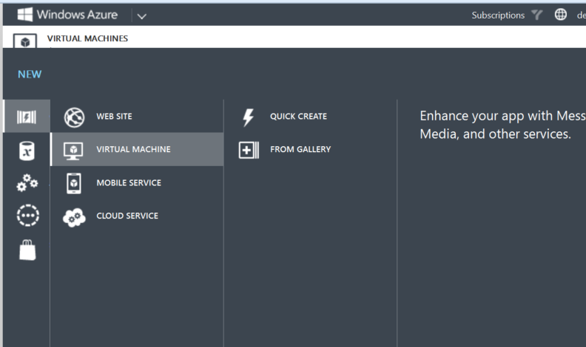
Create a VM from the Windows Azure portal

Slide 11
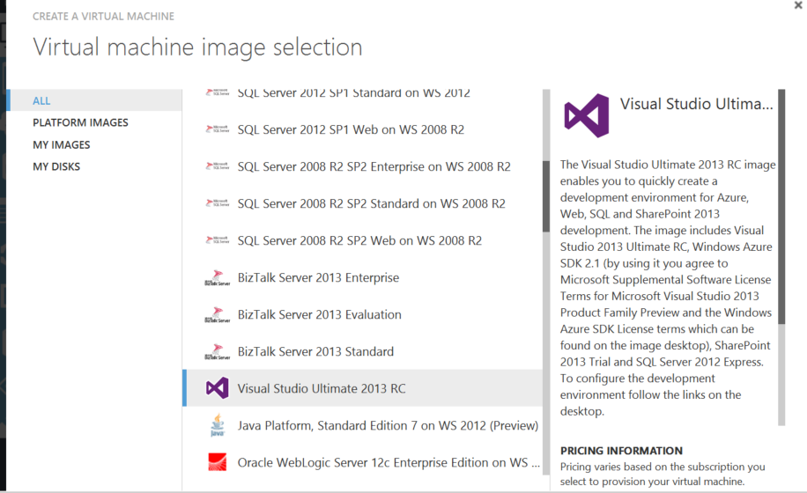

Slide 12
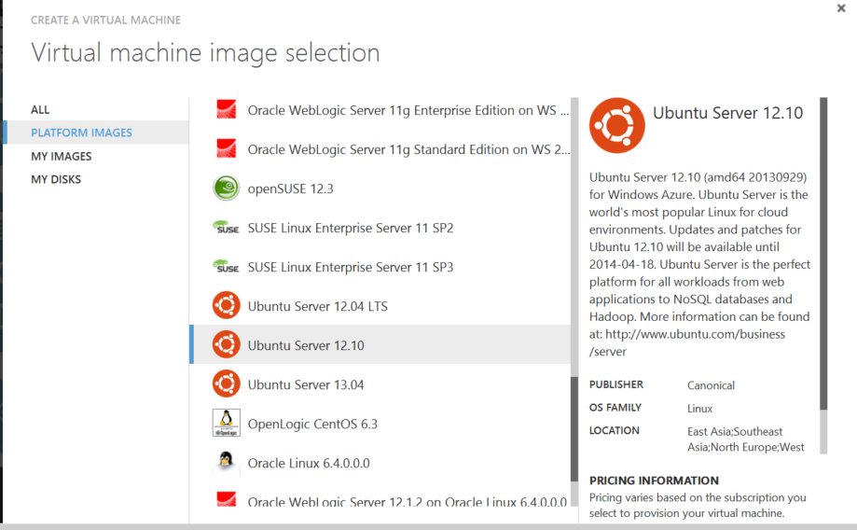

Slide 13
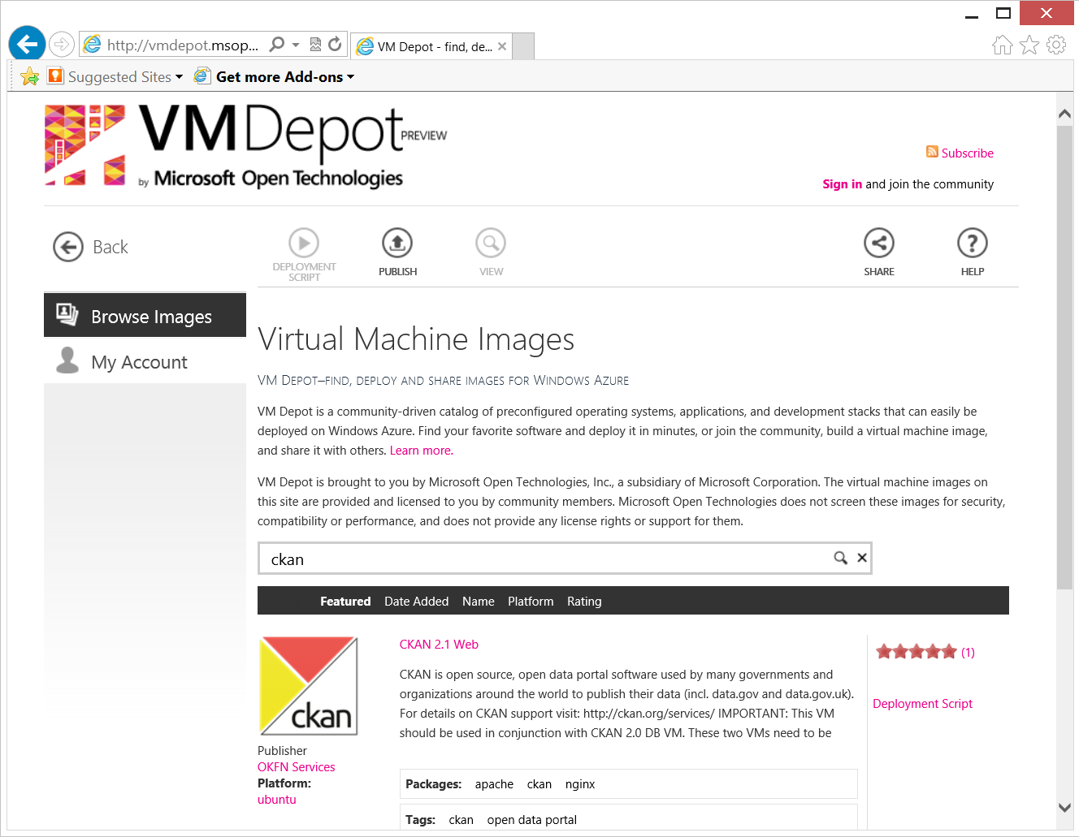
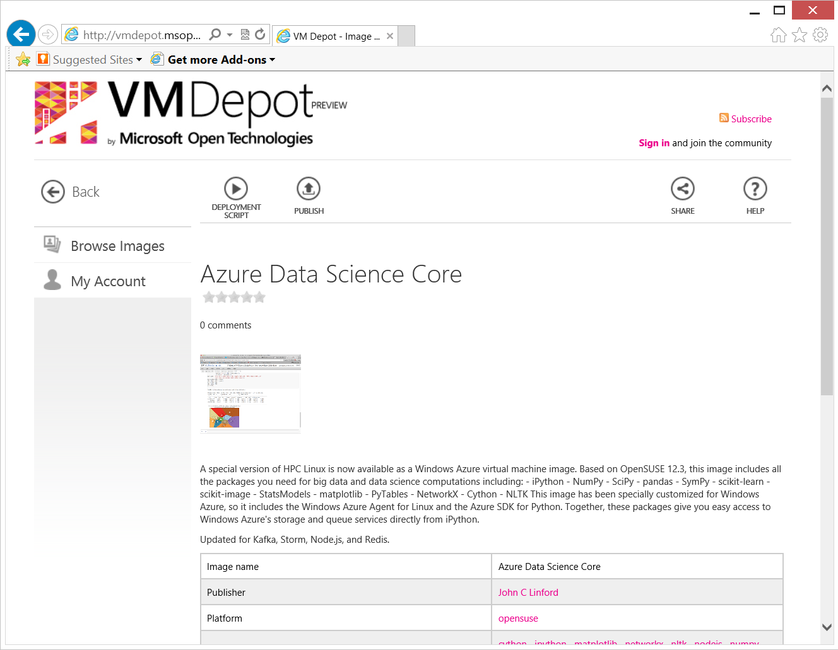
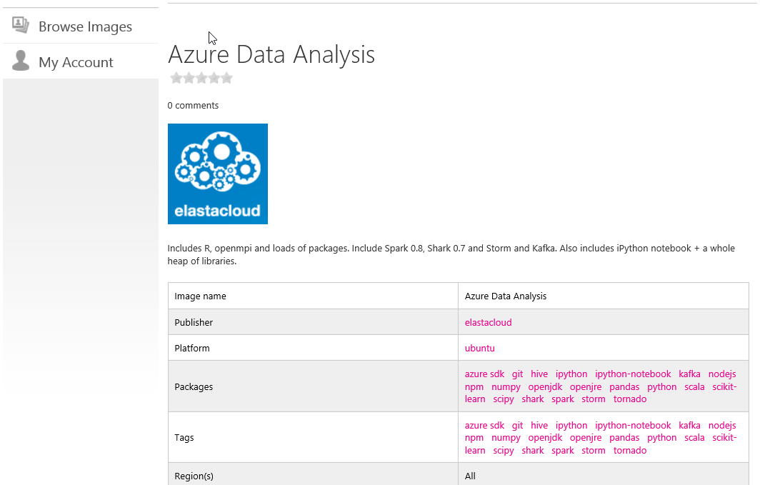
Linux Virtual Machines from the VMDepot
Notes:
http://vmdepot.msopentech.com/Vhd/Show?vhdId=8689&version=9728

Slide 14
Virtual Machines Availability

Slide 15
Service Level Agreements
Availability set
99.95% for multiple role instances
4.38 hours of downtime per year
Server 1
Server 2
What’s included
Compute Hardware failure (disk, cpu, memory)
Datacenter failures - Network failure, power failure
Hardware upgrades, Software maintenance – Host OS Updates
What is not included
VM Container crashes, Guest OS Updates
SLA 99.95
Notes:
Slide Objective:
You need an availability set for a 99.95% SLA
Notes:
Without at least two virtual machines performing the same workload grouped into an availability set you get a 99.95% SLA.

Slide 16
Fault and Update Domains
Fault Domains
Represent groups of resources anticipated to fail together
i.e. Same rack, same server
Fabric spreads instances across fault at least 2 fault domains
Update Domains
Represents groups of resources that will be updated together
Host OS updates honour service update domains
Specified in service definition
Default of 5 (up to 20)
Fabric spreads role instances across Update Domains and Fault Domains
Notes:
Slide Objective:
Discuss achieving very high availability with Windows Azure
Notes:
Fault Domain is a physical unit of failure, and is closely related to the physical infrastructure in the data centers.
In Windows Azure the rack can be considered a fault domain. However there is no 1:1 mapping between fault domain and rack.
Windows Azure Fabric is responsible to deploy the instances of your application in different fault domains.
Obviously this only applies if you run more than 1 instance
Right now Fabric makes sure that your application uses at least 2 (two) fault domains, however depending on capacity and VM availability it may happen that it is spread across more than that.
As a developer u have no direct control over how many fault domains your application will use but the way you configure it may impact your availability
Upgrade Domain is a logical unit, which determines how particular service will be upgraded.
The default number of upgrade domains that are configured for your application is 5 (five). You can control how many upgrade domains your application will use through the upgradeDomain configuration setting in your service definition file (CSDEF).
Windows Azure Fabric ensures that particular upgrade domain is not within single fault domain
That is Upgrade domains are orthogonal to fault domains
Roles are then spread out over upgrade domains and fault domains. Subject to running a reasonable number of instances this removes the risk of a single point of failure

Slide 17
Virtual Machine Availability Sets Update Domains are honored by host OS updates
Fault Domain
Fault Domain
Rack
Rack
Virtual Machine
Virtual Machine
Availability Set
IIS1
IIS2
UD #1
UD #2
Availability Set
Virtual Machine
Virtual Machine
SQL1
SQL2
UD #1
UD #2
Notes:
Slide Objective:
Explain availability sets
Notes:
Availability sets tell the Fabric Controller to place VMs in the same set on different racks for faults and in separate upgrade domains for updates.
This essentially tells the FC not to take the guest OS down of all VMs in the same set for host updates.

Slide 18
Virtual Machine Data Disks

Slide 19
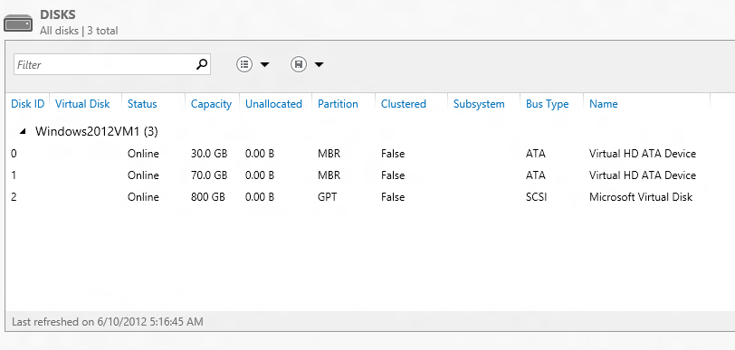
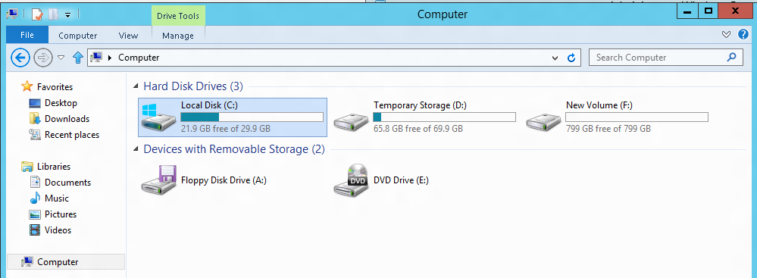
VM disk layout
OS Disk
Persistent
SATA
Drive C:

Slide 20
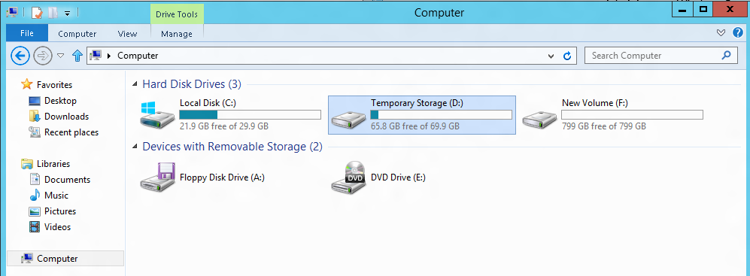
VM disk layout
Temporary Storage Disk
Local (Not Persistent)
SATA
Drive D:

Slide 21
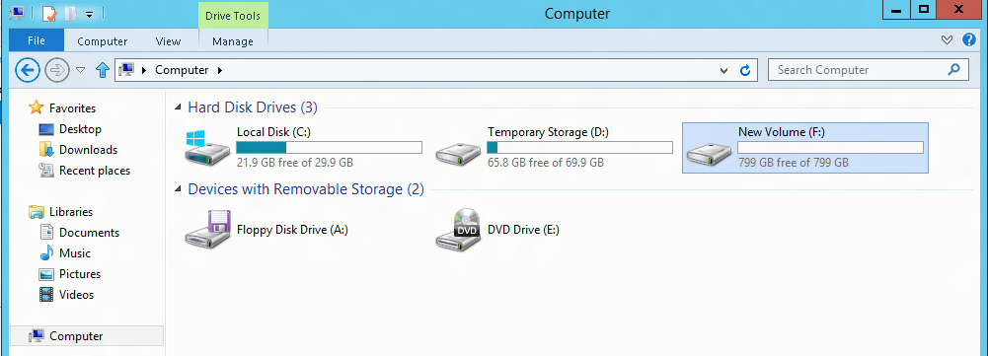
VM disk layout
Data Disk(s)
Persistent
SCSI
Customer Defined Letter

Slide 22
Persistent Disk Management
Capability | OS Disk | Data Disk
Host Cache Default | ReadWrite | None
Max Capacity | 127 GB | 1 TB
Imaging Capable | Yes | No
Hot Update | Cache Setting Requires Reboot | Change Cache Without Reboot, Add/Remove without Reboot.
C:\ = OS Disk
D:\ = Non-Persistent Cache Disk
E:\, F:\, G:\ ... Data Disks
Notes:
Slide Objective:
Highlight the differences in default cache policy between the OS disk and DataDisk

Slide 23

Persistent Disks and Highly Durable
Windows Azure Storage (Disaster Recovery)
Windows Azure Storage
Virtual Machine
Notes:
Slide Objective:
Explain how disks are durable and how Windows Azure storage works
Notes:
The OS and Data Disks are stored in Windows Azure storage. So in addition to the data being persistent you also get the benefits of storage which means your VHD is replicated 3X’s locally and also 3X’s in a separate data center in the same region (geo-replication)

Slide 24
Persistent Disks and Highly Durable
Windows Azure Storage (Disaster Recovery)
Windows Azure Storage
Virtual Machine
Virtual Machine
Notes:
Slide Objective:
This slide simply highlights that if the physical hardware backing your VM goes down a new server will start and pick up the same VHD.

Slide 25
Virtual Machines Images

Slide 26
Disks and Images
OS Images
Microsoft
Partner
User
Base OS image for new Virtual Machines
Sys-Prepped/Generalized/Read Only
Created by uploading or by capture
Disks
OS Disks
Data Disks
Writable Disks for Virtual Machines
Created during VM creation or during upload of existing VHDs.
Notes:
Slide Objective:
Explain the differences between disks and images with VMs

Slide 27
Image Mobility
On-Premises
Cloud
MyApp.vhd
Notes:
Slide Objective:
Explain the benefits of image mobility
Notes:
One of the key benefits of IaaS is flexibility and control. The Windows Azure solution provides the capability of not only moving VHDs TO the cloud but also allows you to copy the VHD back down and run it locally or on another cloud provider. Great for testing out production issues or any other need where you require a copy of the production server.

Slide 28
Bring Your Own Server/VHD
On-Premises
Cloud
MyApp.vhd
On Premises Virtual Server
Provision VM from Image or Disk using portal, script or API
Use Case
Forklift Migration of VMs
Sys Prepped Images
VHD Must Be Fixed Disk
* CSUpload Can Convert on Upload
Upload VHD
Create Disk or
Image
Notes:
Slide Objective:
Explain workflow for bringing your own VHD
Notes:
This use case is when you already have a “golden image(s)” your company uses for server provisioning or you have a VM running on premises that you would just like to run in our data center. You take the vhd – use CSUpload or System Center App Controller to upload as a page blob to a storage account. From there use the portal to add as an image (sysprepped) or disk (configured VM) and there you can create a VM based off of the vhd.

Slide 29
Gallery Experience
Lowest barrier of entry
Partner created images
Click through provisioning
Leverage portal to:
Provide Images (VHDs that include ICs and agent)
Associate SSH Keys
Collect configuration information
Drive provisioning
Notes:
Slide Objectives:
Provide context for functionality available in the Gallery experience

Slide 30

Bring Your Own Linux
Expert Customers that want to tweak, customize, create images based on supported distributions
Customer will
Use Hyper-V to install Distribution
Add ICs and Agent
Generate the VHD
Capture configuration
Generate resources
Upload and start instance
Linux Native: Tools, libraries, scripts
Notes:
Slide Objectives:
Explain the process around Bring-Your-Own-Linux VHD which supports customized images created in Hyper-V
Notes:
Tutorial on WindowsAzure.com: http://www.windowsazure.com/en-us/manage/linux/common-tasks/upload-a-vhd/

Slide 31
Create a Windows VM
HOL
Notes:
1 – simple Example
2 – Real world – KINECT!

Slide 32
Create a Linux VM
HOL
Notes:
1 – simple Example
2 – Real world – KINECT!

Slide 33
The platform image gallery
HOL
Notes:
1 – simple Example
2 – Real world – KINECT!

Slide 34
Using VM Depot
HOL
Notes:
1 – simple Example
2 – Real world – KINECT!

Slide 35
Adding Data Disks to a Windows and Linux VM
HOL
Notes:
1 – simple Example
2 – Real world – KINECT!

Slide 36
For the Next Lab:
Leave your VMs Running
We will be using them for the next lab.

Slide 37
Virtual Machines
Learning objectives – what we have learned:
The wide variety of pre-configured virtual machines available from the gallery
How to make your own virtual machine from an existing installation
An example using Windows and Visual Studio
An example using Linux and IPython notebook

Slide 38
Application Scenarios
Web Sites
Cloud Services
Virtual Machines
Modern web apps
Perfect if your app consists of client side markup and scripting, server side scripting and a database. Powerful capability to scale out and up as needed.
Multi-tier applications
Cloud-based applications that separate application logic into multiple tiers (i.e. caching middle tier, asynchronous background processes like order processing) using both Web and Worker Roles
Enterprise server applications
Run your existing enterprise applications in the cloud, such as SQL Server, SharePoint Server or Active Directory.
Continuous development
Deploy directly from your source code repository, using Git or Team Foundation Service.
Apps that require advanced administration
Cloud-based applications that require admin access, remote desktop access or elevated permissions
Porting existing line of business apps
Choose an image from the library or upload your own VHD.
Popular open source apps
Launch a professional looking site with a few clicks using apps like WordPress, Joomla!, Drupal, DotNetNuke and Umbraco
Apps that require advanced networking
Cloud-based applications that require network isolation for use with Windows Azure Connect or Windows Azure Virtual Network
Windows or Linux operating system
Support for Windows Server, along with community and commercial versions of Linux. Connect virtual machines with cloud services to take full advantage of PaaS services.
Notes:
Leave in appendix for QA when the question is asked.

Slide 39
© 2013 Microsoft Corporation. All rights reserved. Microsoft, Windows, Windows Vista and other product names are or may be registered trademarks and/or trademarks in the U.S. and/or other countries.
The information herein is for informational purposes only and represents the current view of Microsoft Corporation as of the date of this presentation. Because Microsoft must respond to changing market conditions, it should not be interpreted to be a commitment on the part of Microsoft, and Microsoft cannot guarantee the accuracy of any information provided after the date of this presentation. MICROSOFT MAKES NO WARRANTIES, EXPRESS, IMPLIED OR STATUTORY, AS TO THE INFORMATION IN THIS PRESENTATION.

